Slide 1

Effective Scientific Presentation
Tips and Tools
Prof. Mirza Hasanuzzaman
Department of Agronomy
Sher-e-Bangla Agricultural University

Slide 2
Why Give A Presentation?
Three Main Purposes
Inform
Persuade
Educate

Slide 3
Definitions
Presentation
“Something set forth to an audience for the attention of the mind “
Effective
“…producing a desired result”

Slide 4



Watch the Experts
Watch clips from great public speakers and find out what they do right.
Pick up on their posture, tone, volume, hand gestures, eye contact, attire, any audio/visual aids, message, and more!
Notes:
Here are a few links of some great speakers!
Steve Jobs Introducing the iPhone: http://www.youtube.com/watch?v=MnrJzXM7a6o
Take a look at the humor that Jobs introduces into the presentations, the minimalist approach to visual aids (key images, minimal text)
Analysis of Barack Obama’s Speech 2004: http://www.youtube.com/watch?v=OFPwDe22CoY
World Championship of Public Speakers:
http://www.youtube.com/watch?v=LK_N_3NvDbA&list=SP108F5E96477C3C45&src_vid=rvbg9kFDTxg&feature=iv&annotation_id=annotation_437479

Slide 5


Dress to Impress
Be sure to look the part.
Know your audience and don’t fall short of their expectations.
If it is a formal event, be sure to look the part.
Remember it is always best to overdress than to underdress.
Notes:
Your attire speaks volumes. Use your attire to present yourself as someone with confidence, knowledge, and authority. There are many different ways that a presenter could dress for a presentation. The top three categories include: casual, business casual, or business formal. The majority of presentations on a college campus are going to fall within the business casual category.
Casual attire would be appropriate for any low level presentation. Think about giving a presentation at a causal club meeting, hall council, weekly class assignment, etc. Wearing business casual to a casual event is generally a widely appropriate and acceptable form of attire. Wearing formal wear may feel awkward for both you as the presenter and for the audience. Casual attire consists of jeans, t-shirt, casual button up shirt, etc. Here are links to images of some examples:
http://media-cache-ak0.pinimg.com/736x/40/53/8f/40538fbd7cc383f55d7410c298758702.jpg
http://whatcanyoudowiththat.files.wordpress.com/2012/04/dress-down-day.jpg?w=200
Business Casual attire would be appropriate for the widest range of presentations including but not limited to: in class presentations, higher level club meetings, office work attire. It is more so important with business casual clothing that it is neat, clean, pressed, and does not look heavily worn. Here are some examples:
http://www.utexas.edu/finearts/sites/default/files/imgs/business_casual_-_male4_0.jpeg
http://fashionhoster.com/wp-content/uploads/Business-Casual-Fashion-Women-For-Summer-Season-0016.png
Business Formal attire is generally reserved for an end of the year presentation, a large presentation at a conference or awards ceremony or other high level speaking engagement. A great way to find out how to dress is to look at an invitation to the event. Be sure that if you are presenting that you are dressing up instead of dressing down. Here are some examples:
http://spc.fotolog.com/photo/28/54/119/celliachen/13654961014175_f.jpg
http://wardrobelooks.com/wp-content/uploads/2013/09/Timeless-Suits-for-Women-7.jpg

Slide 6
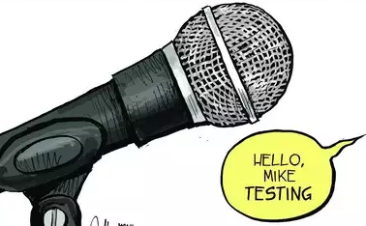
Visit the Space Before Presenting
Get to know the space that you will be presenting in.
Test out any audio and visual aids that you will be using.
Notes:
You may be invited to speak at a venue that you have never visited before. Ask if you can see the space before your presentation. If possible do a run through in that space using your audio/visual aids including any microphones that may be used. If you are using a sound system it is important to run a sound check (even if its just a few words to adjust the volume).

Slide 7
Know Your Material
Be sure to have a strong knowledge base for the material that you are covering. This will be helpful if a question arises about the topic.
Also, know your presentation! Know the content and order of your slides.
Notes:
Try to learn as much as you can about the topic in which you are presenting about. Know more than what is written on your slides and try to anticipate any questions that your audience may have that are not addressed in your presentation. Understand that you may not have an answer to all the questions posed to you. And that’s okay! If you are able to follow up and find the answer offer that to your audience member, just be sure to follow up with an answer!
Know the content of your actual presentation. Remember a few key points: the order of your slides, the purpose of your slides, any additional information that you are presenting that is being supplemented by your slide.

Slide 8
Content
coherent
complete
correct
There are 3 C’s to consider:
clear
concise
concrete
Tip:
Try to share one thing no one knows
Notes:
Here is an article with the 7 C’s of Communication in which this slide was adapted from:
http://www.mindtools.com/pages/article/newCS_85.htm
You can apply many of these principles of written communication into your public speaking content. It is often more difficult to perfect these 6 C’s when communicating verbally with a live audience instead of having time to write, review, re-write, re-review, and edit a written piece.
Write down the points you want to hit upon and any key phrasing/vocabulary you want to use and practice constructing these thoughts into sentences. Have someone else listen to your presentation and get feedback on the content. Are you explaining your message in the most effective way possible?

Slide 9

Body Language and Personality
Watch yourself in the mirror when you are practicing or record yourself on camera.
Be aware of your body language, what is it conveying to your audience?

Slide 10
Practice, Practice, Practice
Run through your presentation on your own. Pay attention to your:
Voice- Tone, inflection, volume, speed, pauses
Filler Words- ‘um,’ ‘you know,’ ‘like’
Areas of difficulty in your presentation
Notes:
You have watched the experts, picked out and tried on your presentation outfit, visited the space, studied your material, and perfected your content and body language. Now practice! Focus on your voice as you practice, pay particular attention to how you say the words you have written, your attitude as you present, any filler words that you use when you are trying to remember what to say next, etc. Is there a particular area of your presentation that you are having trouble remembering? Any words that you are having trouble pronouncing? Spend time on those areas and bring them up to par.

Slide 11
Get Feedback
Share your presentation with a friend, classmate, professor, or anyone who is willing to give you feedback.
Adjust your presentation with their feedback and then get feedback again.
Notes:
Get feedback from others! Find someone who is willing to watch and listen to your presentation and provide constructive criticism. Ask someone who you think is a good public speaker.
A great way to improve is to give yourself feedback. Record yourself giving the presentation and watch it back several times. It is always a little uncomfortable or awkward to watch yourself speak and present, but watch yourself with a critical lense towards your content, body language, personality, voice, and visual aids. Try different presentation styles and feel free to experiment. Watch yourself presenting in different ways and pick your favorite style.

Slide 12
Prepare for the Unexpected
Are you ready for:
No Internet
Lost PowerPoint
Cell phone ringing
Late entrance
Different size audience than expected
Notes:
We live in an imperfect world and things do not always go the way we planned. Here are some common incidents that can potentially throw off your presentation. Think of ways to overcome them.
No Internet: have your presentation saved both online as well as on a flash drive, if your presentation has a video that is only accessible online be prepared to skip the video and talk about some of the take away points from the video.
Lost PowerPoint: In the case that the internet is down and that you lost your flash drive on the way to your presentation, be ready to give your presentation without your PowerPoint. Make sure you know your presentation without the help of your visual aids. Feel free to change up the format of your presentation now that you will not have a PowerPoint. This could be a great opportunity to make your presentation more interactive in order to keep your audience engaged.
Cell Phone Rings: Your phone should be turned off. If someone in your audience has their phone go off, continue speaking. If the phone rings more than once or twice, take a pause, you don’t want your audience to be distracted and miss your information. There is no need to yell at someone to turn off their phone or to say “everyone should silence their phones” as it can come off as rude.
Late Entrance: If someone walks in late to your presentation, don’t let it distract you. If they are standing in the back and there are available seats, feel free to point those seats out. If a substantial number of people walk in late, feel free to quickly catch them up on the current topic being discussed.
Different Size Audience: If you were planning for a large talk but a smaller group of people showed up, be flexible and change up your presentation style. Smaller groups often take on a more intimate feeling and often make it easier for presenter/audience interaction. Instead of standing in front of five people with a microphone, sit with the group and drop the mic.
If you were planning for a small group and a large group of people are trying to get into your presentation, it is okay to only allow in the number of people that the room can accommodate. Sometimes we are at a round table and all the seats at the table are full, the seats around the room are also full, and there are people standing. Feel free to say that the room is at capacity, have a sign-up sheet for information via email for those who were not able to get into your presentation.
Forgot Handouts for Audience: If you had prepared handouts for your audience, but left them at home, don’t fret! Try to improvise, if it was a chart you wanted them to fill out ask your audience to take out a piece of paper and complete the exercise without your handout. If your handout was an informational handout, pass around a sign in and ask for audiences’ email address and let them know that you will email them a handout.
Lost Index Cards/Presentation Notes: Sometimes it is helpful to keep an outline of topics or bullet points to discuss during a talk but what happens when you lost these notes or dropped them on the ground? If you are using index cards, be sure to number them. If you drop them this will make it easier to put them back in order. If you left your notes at home be confident in yourself that you have practiced your presentation enough that you will be able to present without them.
Too Many Audience Questions: If you are asked to prepare a one hour talk, end ten minutes early. This gives your audience time to ask questions. If there are too many questions and you are running out of time let the audience know, “We have time for two more questions.” Make yourself available, “I will be in the back of the room to answer any further questions.” or “If I do not get around to your question, feel free to email me and I will get back to you.”

Slide 13
Do’s and Don’ts
Do:
Always repeat audience questions
Give audiences something to walk away with
Respect your audience’s time
Don’t:
make excuses
read your slides or verbatim from notes
defer answering questions
overload your slides
Notes:
Do:
-Repeat audience questions, this is especially important if you are in a large room where the rest of the audience did not hear or understand the question being asked. Repeating the question also confirms your understanding of the question to the person asked you the question.
-Give the audiences something to walk away with. What can audiences walk away from your presentation knowing or feeling that they did not know or feel before. What immediate actions do you want them to take?
-Respect your audiences’ time, if you are asked to present for an hour go for 50 minutes, a thirty minute presentation should go for 25 minutes. This allows time for your audience to ask questions as well as insures that you are not stealing time from your audience members. **This is especially true if you are presenting at a conference and your audience needs to get to another presentation, lunch, or home.
Don’t:
-Don’t make excuses, don’t tell your audience that: you just put this presentation together, you didn’t have time to prepare, or that you’re not good at presenting. Have confidence in yourself, the quality of your hard work, and in your abilities.
-Don’t read from your slides, if you can help it don’t even look at your slides. The slides are there to help your audience follow along, not to tell you what to say. Don’t read from your notes, your audience is able to read, but they are attending your presentation to listen to you, don’t read to them.
-If an audience member asks a question that fits well into where you are in your presentation, be sure to answer their question immediately. If they are jumping ahead, you should feel comfortable jumping ahead, answering their question, and then going back and continuing where you left off. The thought behind this philosophy is that you do not want to stifle or hinder any engagement from your audience. If you don’t know the answer to a specific question, thats fine, let them know that you will get back to them and be sure to follow through on your promise to do so.
-Your slides are to act as a visual aid to your audience. Don’t let your visual aid be a visual distraction. Your slides should be simple, easy to follow, and complement your presentation.

Slide 14

Your Turn!
Take your next presentation and practice in front of the mirror. Implement some of the suggestions from this presentation and improve your public speaking skills!

Slide 15
Planning
Why are you doing the talk? Be clear about your purpose
Find out how big your audience is likely to be & what sort of group
Make notes about your subject
Don’t write your talk word for word
Use small pieces of paper and number them
Powerpoint has a notes & timing feature which may help
Time your talk & practice it
Then practice it again

Slide 16
Think of Threes
Tell people what you’re going to say
Tell them
Tell them what you’ve said

Slide 17
Do’s
✓
Take a deep breath
Speak clearly
Make small cards to remind yourself of topics (number them!)
Be aware of where your audience is - are you facing all of them?
Smile, have fun
Be yourself and project your personality
Remember - no-one knows how you feel or what you think
Remember - The audience is on your side!

Slide 18
Don’ts
✗
Rush what you’re trying to say – SLOW DOWN
Read off a sheet of paper word for word
Fiddle with things - its irritating!
Use inappropriate language for your audience
Panic

Slide 19
Techniques
Pace of delivery
Vary style
Move about
Vary pitch
Use notes
Avoid annoying habits
Use props, but don‘t overdo it

Slide 20

Notes:
Remember a picture is good as 1,000 words

Slide 21
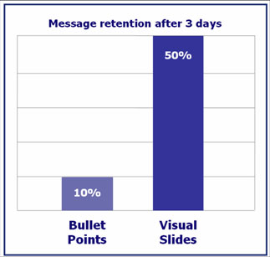

The use of visual aids

Slide 22
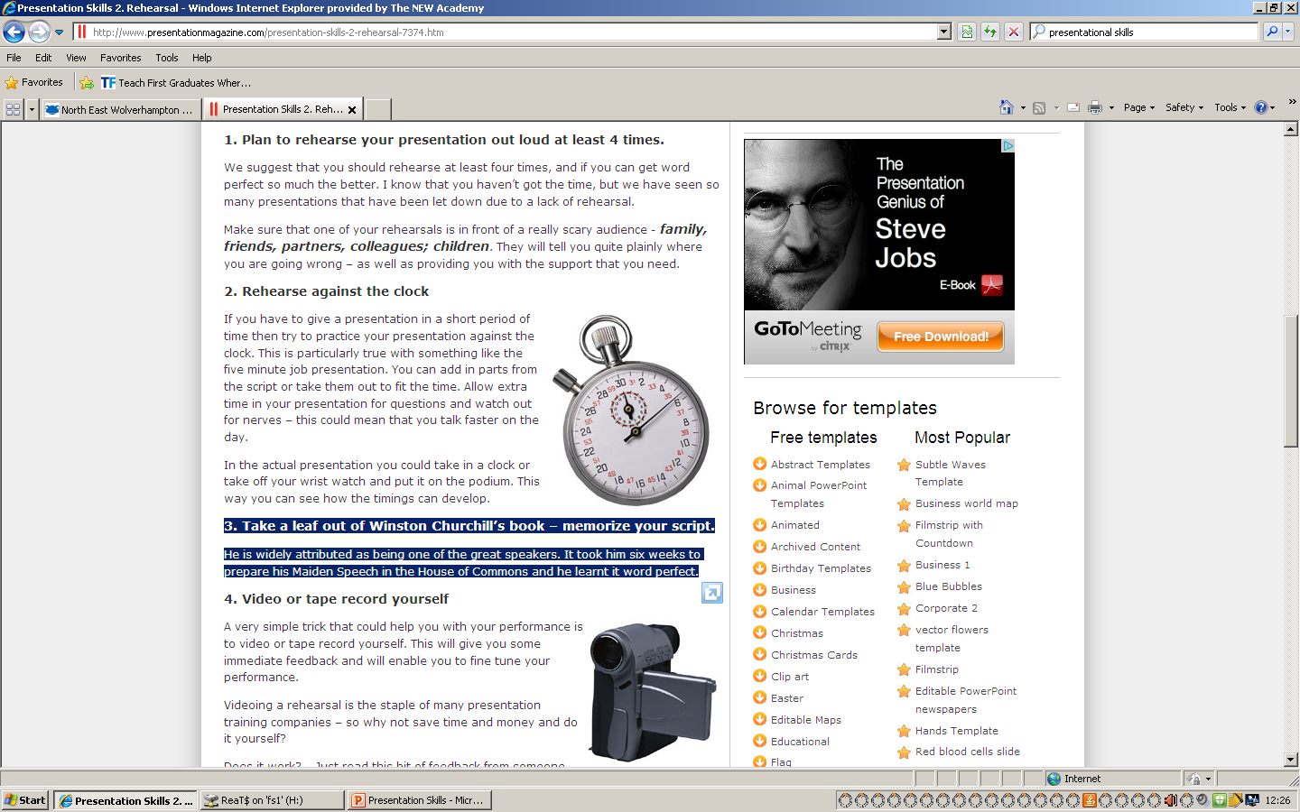
Practice!
“If you fail to prepare, you are prepared to fail”
Rehearse your presentation and it will get better.
Rehearse against the clock!

Slide 23
Structure Your Presentation
A common structure
  Title page ~1 min
  Agenda ~1 min
  Background (optional) ~1 min
  Problem statement ~2 min
  Objective & scope ~1 min
  Methodology ~2-3 min
  [Research Implementation] ~6-8 min
  Results & analysis ~6-8 min
  Conclusion ~1 min
  Future research (optional) ~0.5 min
  Final slide – Q&A N/A
Total: ~20 min
Notes:
All research presentations follow a similar structure. Here is a common structure of a presentation, along with possible time allocation to each section. Of course, you may want to customize the structure to fit your case. The goal is to (1) make your presentation progression more predictable and easy to follow; (2) reduce the amount of generic background information and devote more time to YOUR work (what is the problem, what did you do and why, what did you achieve by the end, what does the result mean). We will next go step-by-step for the content of each section.

Slide 24


Title Page
You can't make a first impression twice
Title page elements
  A concise and meaningful title
  Your name and affiliation
  Presentation date
Notes:
Making a Powerful First Impression. The audience will make decisions about you from your first appearance, your words and the sound of your voice. You can't make a first impression twice. Plan your opening sentences and practice them in front of a mirror. Use short sentences. Keep technical information at a minimum here. Grab attention with an interesting fact, a quotation, or a provocative question to arouse curiosity and get the audience’s attention. Also, don’t forget to introduce yourself – but keep it brief.

Slide 25





Future Agronomy Towards
Agriculture 4.0
Bangladesh Society of Agronomy
21st Conference of the Bangladesh Society of Agronomy
05 November 2022
Keynote Paper
Prof. Mirza Hasanuzzaman, Ph.D., FBAS, FRSB
Department of Agronomy
Sher-e-Bangla Agricultural University, Dhaka
www.mirzahasan.info.bd

Slide 26
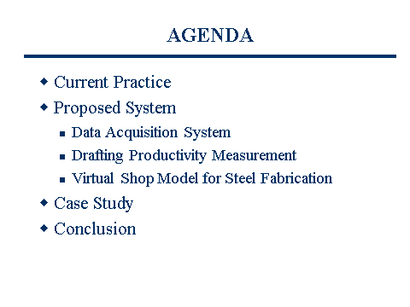
Agenda
Use agenda to clarify the structure of your presentation
  Make the presentation appears more organized
  Audience feel comfortable when they know where you will go
Use short phrases
Briefly explain the agenda, don’t just skip it
  I’ll first … then …
“House rules”
  Due to the time limit, ask the audience to keep their questions to the end, tell them you have a Q&A session

Slide 27

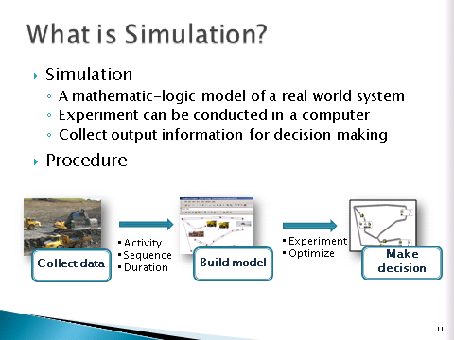
Background (Optional)
Justify why your research area is important
  Consider using numbers/charts/facts quoted from credible sources to support your argument
Prepare your audience
  Assumption: audience with basic CM knowledge, but not in-depth knowledge in your particular research area
  Explain use simple language the significance of the research area and necessary background info.
Note: Background slide may be ignored, if the research area is well-known, you can skip it and go to “Problem Statement”
Notes:
Why do we care about the problem and the results? If the problem isn't obviously “interesting,” it might be better to put motivation first; but if your work is incremental progress on a problem that is widely recognized as important (e.g. enhance construction productivity), then it is probably better to put the problem statement first to indicate which piece of the larger problem you are breaking off to work on. This section should include the importance of your work, the difficulty of the area, and the impact it might have if successful.

Slide 28
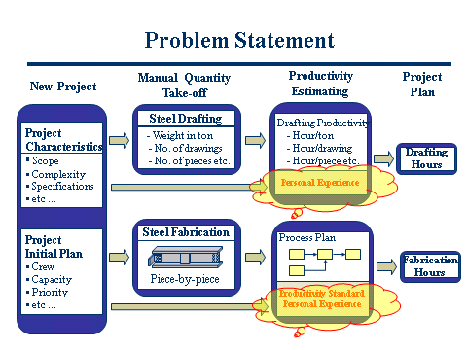
Problem Statement
Describe the exact research problem
  Focus on the specific problem addressed by YOU only
  Avoid statements that may be confusing/offensive unless you have adequate supporting data
    E.g. “the construction industry fails totally to ….”
    Construction managers do not understand …”
  Briefly state literature review results (I’m not reinventing the wheel …)
Visual aids (diagram, photos…) may help to highlight problem areas
Notes:
Provide a clear concise description of the issues that need to be addressed - What is the specific problem in that research area that you will address (e.g. lack of understanding of a subject, low performance …)? You may also briefly mentioned your findings from literature review. By definition, a literature review is a summary of previous research on the research problem and their strength and weakness - what is known/what has been done by others? However, due to the time limit, your statement must be brief, just to confirm the audience that you are aware of past researches and you are not reinventing the wheel. After all, the focus is YOUR work, don’t waste time on explaining others’ work! For example, “My literature review shows that many past researches has been done in …., they made progress on … but there is still a lack of …. (this is your research problem). This statement should be enough.

Slide 29
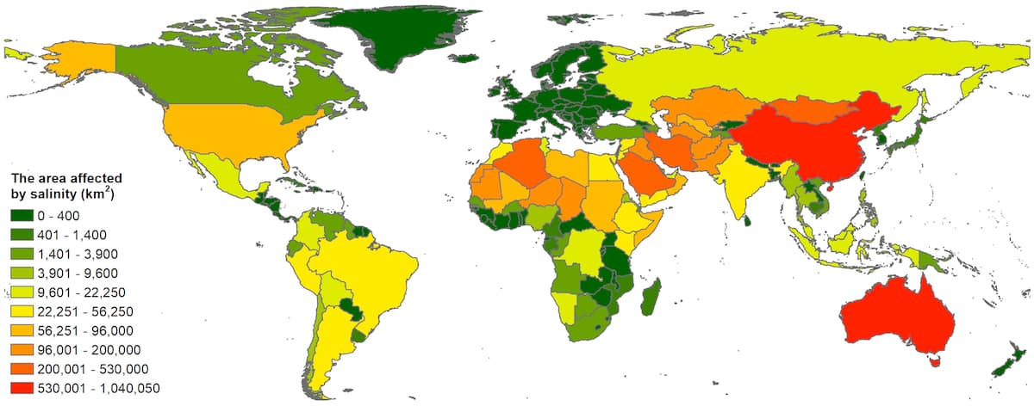
More than 833 million hectares of land worldwide are salt-affected, accounting for 8.7% of the total land area, and the number is constantly increasing. (Food and Agricultural Organization, 2022).
Global salinity-affected area

Slide 30
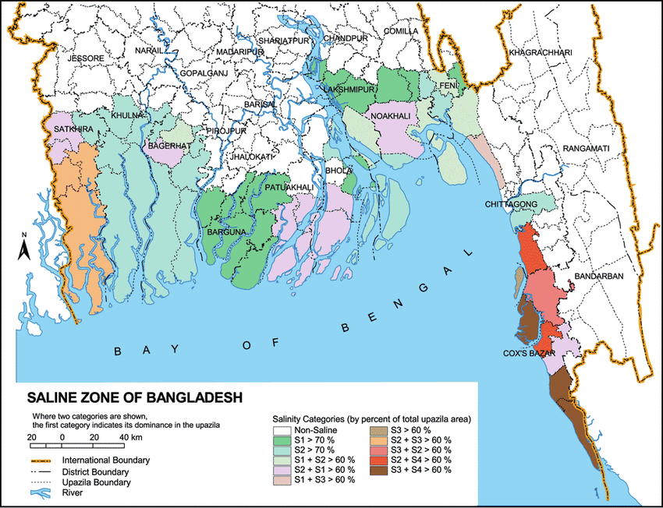
Figure 2. Salinity-affected areas in Bangladesh (Haque et al., 2016).

Slide 31
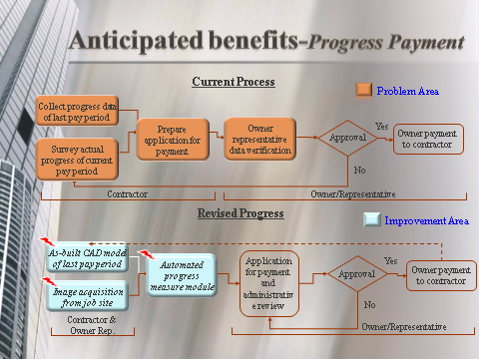
Objective & Scope
List your objectives and sub-objectives
  Your objectives must match to your problem
  Try to visualize the objective using visual aids, if possible
A brief statement of scope, if necessary
Visual aids may help to highlight both problem and improvement (objective) side by side for better understanding
Notes:
Objectives is a list of goals that will be achieved through the proposed research – What are the benefits/impact (e.g. better understanding, improved productivity …) that will be generated if the research problem is answered?

Slide 32
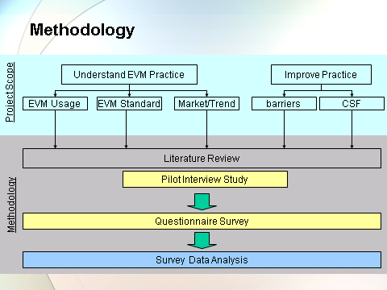
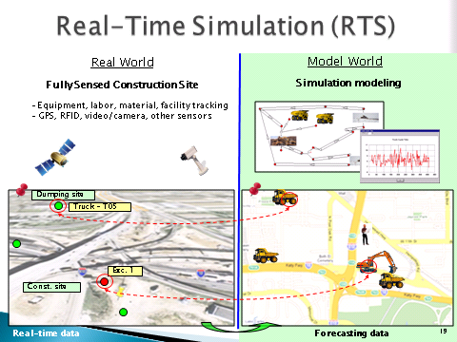
Methodology
A global view of research steps and logic
  Use visual aids as much as your can
  Explain each major research step briefly, don’t miss any
Flow chart is usually better than texts in explaining research steps
Photos, diagram, animation can help to explain complex research ideas
Notes:
A research methodology defines the research activities and research methods - What to do and how to do to solve the problem?

Slide 33
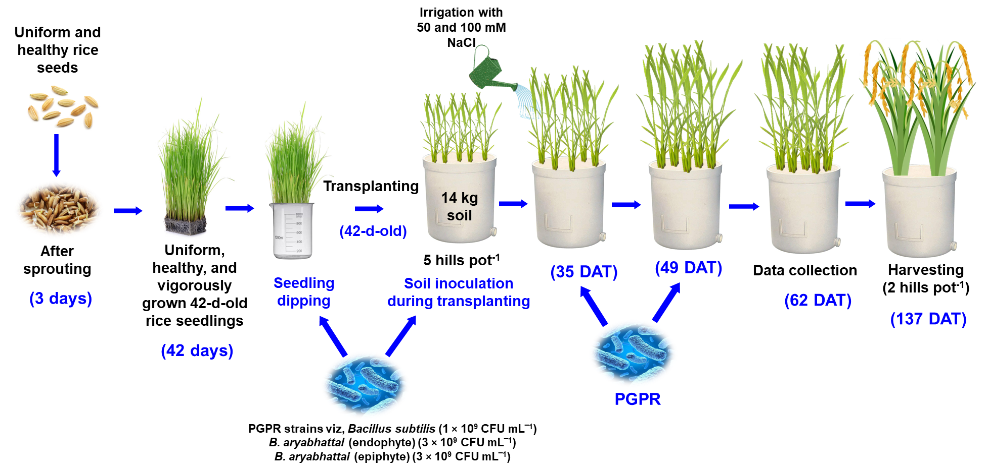
Figure 6. Experimental materials and methodology.

Slide 34
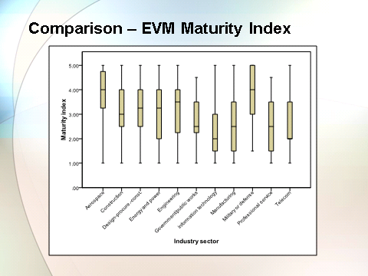
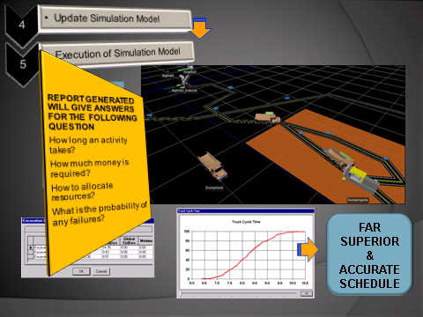
Results
A description of results/deliverables
  Allocate adequate time to present
  Don’t sell yourself short!
  Visualize your results using visual aids or live demo!
  Deliverables must match to your objectives
Notes:
This is where you can shine – show off your results, don’t settle for any less than what you have achieved!

Slide 35
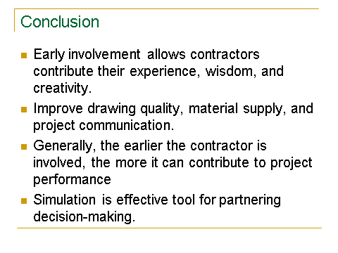
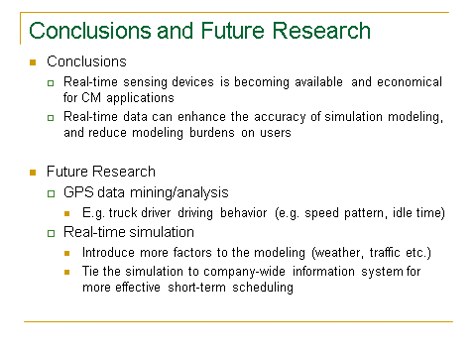
Conclusions
A concluding remarks …
  A quick reflection of your research problem
  A quick summary what you have done
  Highlight your achievements
    Reassure the audience your academic & practical value of your research
  State lesson learned, if any
Notes:
Conclusion is a judgment or decision made after a research - what works, what doesn't work, what lessons are learned, what future research is required

Slide 36
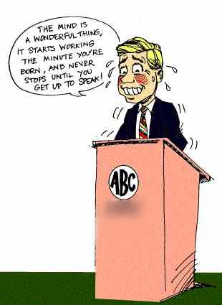
Final remark
Notes:
This would not happen to you, if you are PREPARED – good presentation design PLUS lots of practice.

Slide 37

Podium Panic
For some people, the thought of giving a presentation is more frightening than falling off a cliff, financial difficulties, snakes and even death.

Slide 38
Dealing with Podium Panic
Audiences are forgiving
Nervousness is usually invisible
Be yourself
Practice deep breathing/ visualization techniques
Begin in your comfort zone

Slide 39
Dealing with Podium Panic
Check out the room in advance
Concentrate on the message
Begin with a slow, well prepared intro; have a confident and clear conclusion
Be prepared and practice

Slide 40
Eye Contact
Never let them out of your sight.
Looking them in the eye makes them feel that they are influencing what you say.
Eye contact allows the presentation to approximate conversation—the audience feels much more involved.

Slide 41
Body Language
List of NO’s
Lean on or grip the podium
Rock or sway in place
Stand immobile
Use a single body language repeatedly
Examine or bite your fingernails

Slide 42
Body Language
List of NO’s
Cross your arms in front of your chest
Use obviously practiced or stilted gestures
Chew gum or eat candy
Click or tap your pen, pencil or pointer
Answer a mobile ☺.

Slide 43
Body Language
List of NO’s
Lean into the microphone
Shuffle your notes unnecessarily
Tighten your tie or otherwise play with your clothing
Crack your knuckles
Jangle change or key in your pocket

Slide 44
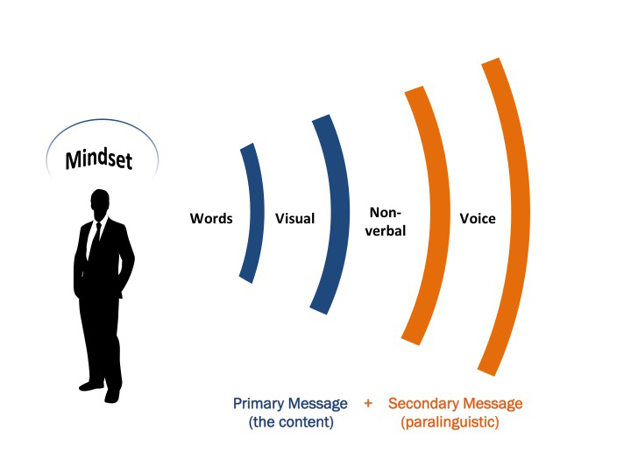
Voice
Voice Intelligibility
Articulation
Pronunciation
Vocalized pauses
Substandard grammar
Voice Variability
Rate of speech
Volume
Pitch or tone
Emphasis
Notes:
Intelligibility=understandability Variability=expresses differences in meaning
Articulation (enunciation)= the precision and clarity with which you utter the sounds of speech. Chiefly the job of the jaw, tongue, and lips. Most articulation problems come from laziness on the parts of these organs.
Pronunciation=traditional or customary utterance of words. Common faults are the misplacement of accent, omitting sounds, adding sounds,and verbalizing silent letters.
Vocalized pauses=uh, um, ah. Know your subject.
Overuse of stock expressions=OK, like, you know. Conveys a lack of originality.
Substandard grammar
Force=variability of volume
Pitch=highness or lowness
Emphasis=stressing certain phrases or sections

Slide 45
Do not read the presentation
A sure sign of an ineffective presenter is when he or she looks at the screen and reads off every last word up on the slides
Loses eye contact with the audience
You also don’t want the audience to have to look at your backside all the time
Practice the presentation so that you can speak from bullet points
The text should be a cue for the presenter

Slide 46
Preparing Content
3 A’s
Analyze your AUDIENCE.
Define what ACTION you want them to take.
Arrange your ARGUMENT to move them.

Slide 47
Analyze Your Audience
What are their names, titles, backgrounds, reasons for attending, etc…?
What are their big concerns?
What are their objectives, fears, hot buttons, and attitudes?

Slide 48
Analyze Your Audience
What is their perception of you and your institution?
What are their questions likely to be?
What is personally at stake for them?
How much detail do they need?

Slide 49
Define What Action
What action do you want the audience to take?
Define it in terms of the audience.
What will they feel, believe, and do after hearing your talk?

Slide 50
Arranging Your Argument
Shake hands with the audience.
Get to the point.
Present your theme.
Develop your agenda point by point.
Summarize and recommend.

Slide 51
Visual Aids
(not the stars of the show)

Slide 52
Design Concepts
Big
Simple
Clear

Slide 53
Questions & Answers
Beginning of a whole new interactive presentation
Opportunity to make a point
Most presentations are won or lost here

Slide 54
Questions & Answers
Anticipate lines of questioning
Rehearse
Don’t rank questions
Keep answers brief
Be honest— on your answers
Avoid negative words
Don’t repeat negative questions
Clarify question
Defer to experts
Move your eyes off questioner
If negative, end your response focused on somebody else

Slide 55
THE Golden RULE
NEVER argue with a member of the audience.

Slide 56
Instead…
Look at the questioner.
Remain neutral and attentive.
Listen to the whole question.
Pause before you respond.
Address the questioner, then move your eyes to others.

Slide 57
Easy as A B C
“I can’t Answer that question Because …, but I Can tell you…”

Slide 58

Stay on time
If you plan a certain amount of time for your presentation, do not go over
If there is no time limit, take less time rather than more to ensure that people stay engaged

Slide 59
Have a Backup Plan
Technology can fail when least expected
Have a backup copy on a flash drive
Don't assume that your presentation will work fine on another computer
Don’t assume the internet will be connected
From a speaker point of view, it is also a good idea to be able to deliver your presentation without the slides just in case of projector failure

Slide 60

Discovering and Using Multimedia
Multimedia software will help you to develop skills to create products that are useful in your role as a teacher.
It lets you create presentations with words, pictures, sounds and videos. e.g PowerPoint.
Multimedia Skills
Knowing PowerPoint
Working with Slides
Building presentations
Making slides look good
Adding words
Adding pictures and effects
Adding sounds, movies, links
Adding animations and effects
Setting up and playing presentations

Slide 61

Traditional vs. Modern Teaching Tools

Slide 62


Slide 63
PowerPoint
"Is PowerPoint bad? No, in fact, it is quite a useful tool. Boring talks are bad. Poorly structured talks are bad. Don't blame the problem on the tool."
Don Norman
Author of
The Design of Everyday Things
Notes:
Restraint…Simplicity…Naturalness
Many experts recommend the 5/5 rule, that becomes the 7/7 rule, that still tends to put bullet points on every slide. Ask yourself, “is this slide necessary?” There is always fat…find it and trim it…

Slide 64
In 1961, Dr. Joseph Foley became the Director of the Division of Neurology within the Department of Medicine. Under his leadership, the Division rapidly grew into a nationally recognized program. Upon his retirement, the Department of Neurology was formed, and Dr. Robert B. Daroff became its first Chairman in 1980. In 1994, Dr. Daroff became Chief of Staff at University Hospitals and Associate Dean at Case Western Reserve University School of Medicine. Dr. Dennis M.D. Landis was appointed in 1995 as chairman. Under Dr. Landis, the Department greatly expanded in faculty and subspecialty programs. Dr. Landis stepped down as Chairman in late 2006, and in January 2008, Dr. Anthony J. Furlan became the present Chairman. The department has continued further growth in programs and faculty and is now part of the Neurological Institute of University Hospitals.
The Department now includes s over 55 faculty at nine sites (University Hospitals-Cleveland Medical Center, Case Western Reserve University School of Medicine, Richmond Heights Medical Center, Bedford Medical Center, Westlake Health Center, Ahuja Medical Center, Suburban Health Center, Park East Medical Center, and the Cleveland VA Medical Center). Within the Department are many Centers, among them, Brain Tumor, Epilepsy, Neuromuscular, Movement Disorders, Stroke and Cerebrovascular, Neuro-Critical Care; Brain Health and Memory, Neuro-Ophthalmology, and General / Community Neurology. The Department Residency Program is one of the largest in the country, and takes up to 12 residents per year, in addition to fellows in Pediatric Neurology, Neuromuscular Medicine, Epilepsy, Vascular Neurology, Neurologic Critical Care, Movement Disorders and Behavioral Neurology.

Slide 65
Powerpoint
Advantages
Disadvantages
Quick, easy & simple
Prepare in advance
Good for large audience
Can include pictures & graphics easily
Something to look at
Can be tedious
Not very dynamic
Easy to overload with information
Be careful with animations
Tendency to read word for word

Slide 66
Basic Rules of PowerPoint® Slides
Mirza Hasanuzzaman
Professor
Department of Agronomy
Sher-e-Bangla Agricultural University

Slide 67

Know Your Audience
Present information relevant to this audience
Stay focused on the main topic
  Be brief
  Avoid “Bird Walks”
Notes:
Jane’s Power Points!
Change your presentation to fit your audience. A single presentation rarely addresses every audience’s needs.
A current date for your last modification can tell everyone that your information is recent and up to date or assembled in haste. An old date can say that you have been prepared for some time, or your information is dated.
And what is with the snowflake pict? Graphics should have a purpose not take up space.

Slide 68

Too many slides can lose your audience

Slide 69
Minimize the Number of Slides
You want a clear message
You want to keep your audience interested
Keep the number of slides to a minimum
Good rule of thumb: try not to exceed one slide per minute

Slide 70
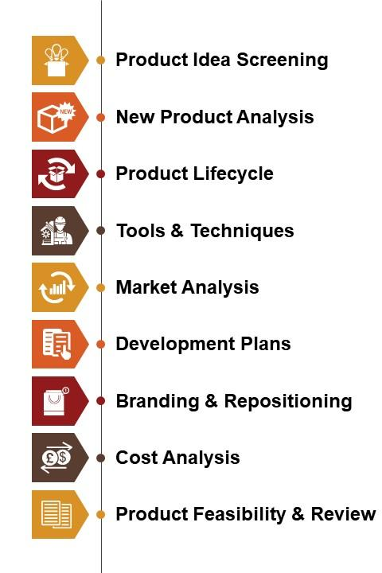
Tips to be Covered
Outlines
Slide Structure
Fonts
Color
Background
Graphs
Spelling and Grammar
Conclusions
Questions

Slide 71
Outline
Make your 1st or 2nd slide an outline of your presentation
  Example: previous slide
Follow the order of your outline for the rest of the presentation
Only place the main points on the outline slide
  Example: Use the titles of each slide as main points

Slide 72

Slide Structure – Good
Use 1-2 slides per minute of your presentation
Write in point form, not complete sentences
Include 4-5 points per slide
Avoid wordiness: use key words and phrases only

Slide 73
Don’t use too much text
Don’t try to fit too much text on any single slide
It is a nightmare for audiences when they see a slide jammed full of text.
If audience members read all the text on a slide, they will not be able to listen to you at the same time
7-10 lines/page max (3-5 is better)
4-8 words/line

Slide 74
Slide Structure - Bad
This page contains too many words for a presentation slide. It is not written in point form, making it difficult both for your audience to read and for you to present each point. Although there are exactly the same number of points on this slide as the previous slide, it looks much more complicated. In short, your audience will spend too much time trying to read this paragraph instead of listening to you.

Slide 75
While nearly 70 percent of the world is covered by water, only 2.5 percent of it is fresh. The rest is saline and ocean-based. Even then, just 1 percent of our freshwater is easily accessible, with much of it trapped in glaciers and snowfields. Globally, agriculture accounts for 80–90% of all freshwater used by humans, and most of that is in crop production. Still, water is the main abiotic stress (Drought) limiting crop production in several regions of the world. In 2030, 47% of the world population will be living in areas of high water stress. Even where water for irrigation is currently plentiful, there are increasing concerns about future availability. The competition from industrial and urban uses is increasing with demographic pressure and rapid industrialization. The scarcity of fresh water is also exacerbated by non-point and point source pollutions, particularly salinization of groundwater aquifers. Global water pollution is on rise as every day two million tons of sewage and industrial and agricultural waste are discharged into the world’s water. Seventy percent of untreated industrial wastes in developing countries are disposed into water where they contaminate the existing water supplies.
Water is considered as the most critical resource for sustainable development in most Mediterranean countries. It is essential not only for agriculture, industry and economic growth, but also it is the most important component of the environment, with significant impact on health and nature conservation. Currently, the rapid growth of population along with the extension of irrigation agriculture, industrial development and climate change, are stressing the quantity and quality aspects of the natural system. Because of the increasing problems, man has begun to realize that he can no longer follow a "use and discard" methodology either with water resources or any other natural resource. As a result, the need for a consistent policy of rational management of water resources has become evident. Global irrigated area has increased more than six fold over the last century, from approximately 40 million hectares in 1900 to more than 260 million hectares (Postel, 1999; FAO, 1999). Today 40% of the world’s food comes from the 18% of the cropland that is irrigated. Irrigated areas increase almost 1% per year (Jensen, 1993) and the irrigation water demand will increase by 13.6% by 2025 (Rosegrant and Cai, 2002). On the other hand 8-15% of fresh water supplies will be diverted from agriculture to meet the increased demand of domestic use and industry.

Slide 76
Slide Structure – Good
Show one point at a time:
  Will help audience concentrate on what you are saying
  Will prevent audience from reading ahead
  Will help you keep your presentation focused

Slide 77
Slide Structure - Bad
Do not use distracting animation
Do not go overboard with the animation
Be consistent with the animation that you use

Slide 78
Don’t try to dazzle the audience with graphics or style…but with the information.
The medium is not the message.
The information is the message.

Slide 79
Fonts - Good
Use at least an 18-point font
Use different size fonts for main points and secondary points
  this font is 24-point, the main point font is 28-point, and the title font is 36-point
Use a standard font like Times New Roman, Arial, Verdana or Tahoma

Slide 80

Format: font
You should consider what font you use in your presentations. Sans-serif fonts are usually more readable on screens.
Some sans-serif fonts are:
Verdana
Calibri
Ariel
Trebuchet
Century Gothic
Serif font
Sans serif font

Slide 81
Fonts-Good
  This is Arial 28 pt and you can easily read it.
  This is Tahoma 28 pt.
  This is Verdana 28 pt and it is very easy to read when projected.
  This is Times New Roman 28 pt and it is not bad to read

Slide 82


Fonts - Bad
If you use a small font, your audience won’t be able to read what you have written
CAPITALIZE ONLY WHEN NECESSARY (e.g. TITLE). IT IS DIFFICULT TO READ
Avoid italicized fonts as they are difficult to read quickly
Don’t use a complicated font
Avoid having a picture of text.

Slide 83
Color - Good
Use a font color that contrasts sharply with the background
  Ex: blue font on a white background
Use color to reinforce the logic of your structure
  Ex: light blue title and dark blue text
Use color to emphasize a point
  But only use this occasionally

Slide 84
Color - Bad
Using a font colour that does not contrast with the background colour is hard to read
Using colour for decoration is distracting and annoying.
Using a different colour for each point is unnecessary
  Using a different colour for secondary points is also unnecessary
Trying to be creative can also be bad

Slide 85
Contrast is important.
  Dark text on a light background.

Slide 86
Use Contrasting Colors
Light colors on dark background.
Dark colors on light background.

Slide 87
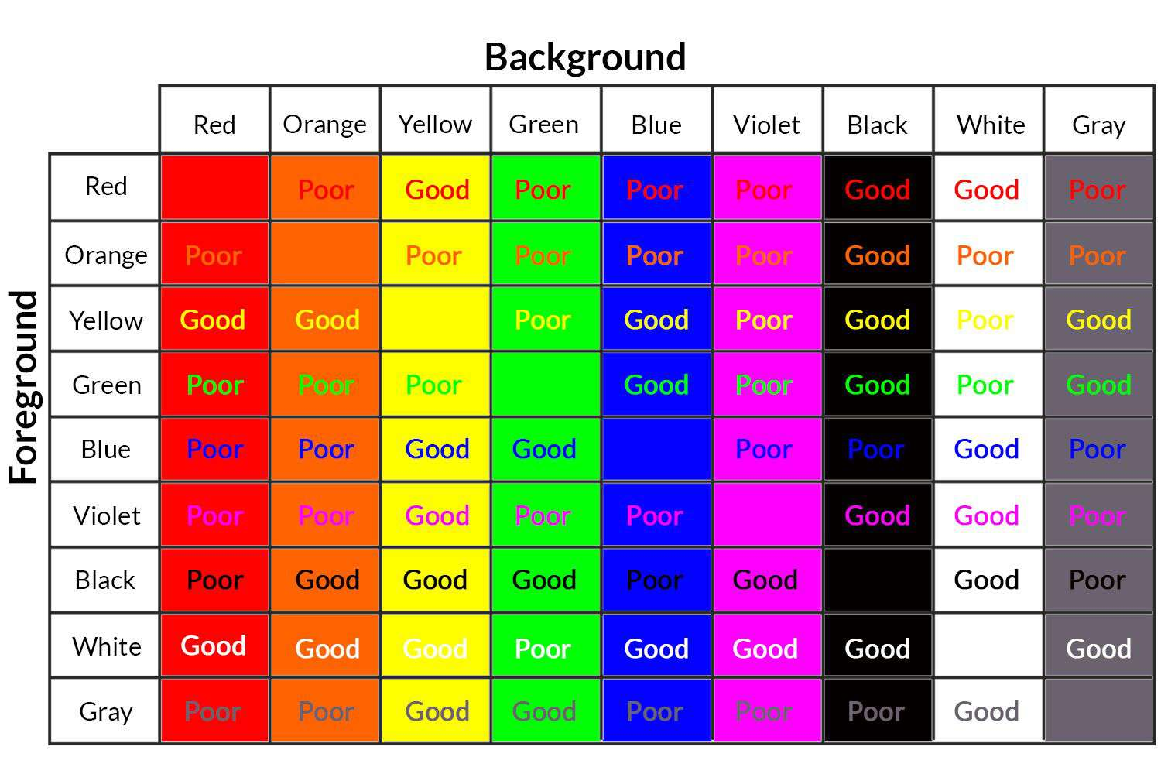

Slide 88
Background - Good
Use backgrounds such as this one that are attractive but simple
Use backgrounds which are light
Use the same background consistently throughout your presentation

Slide 89
Choosing Colors
Dark backgrounds require light colors like white or gold

Slide 90
Choosing Color
Red text on a blue background produces a purple haze

Slide 91
Choosing Color
Green text on a red background looks fuzzy

Slide 92
Background – Bad
Avoid backgrounds that are distracting or difficult to read from
Always be consistent with the background that you use

Slide 93
Using Bullets
Type phrases not sentences
Maintain parallel structure
Use the 6×6 Rule
  6 words per bullet
  6 bullets per slide
Notes:
Jane’s Power Points!
Parallel structure means every bullet in a group begins with a verb or every bullet begins with a noun.
If you have several bullets on a slide and you put them all up at the same time, the audience is going to read all of them when you’re still talking about the first one.
Use natural transition. Text drops from above or enters from the left.

Slide 94
Balance.
Do not center bullet points.
It makes the text ragged.
And hard to read and follow with your eyes.

Slide 95
Generally, left-justify bullets.
This keeps things neat.
Easy to follow.

Slide 96
Using Bullets
PowerPoint provides a variety of bullets
Some are basic
Some are basic
Others may surprise you
Select bullets that enhance your presentation
* In bullet point lines, capitalize the first word and no other words unless they normally appear capped
Notes:
Jane’s Power Points!

Slide 97
Graph and Charts
Keep graphs, charts and diagram simple, if possible.
Use bar graphs and pie charts instead of tables of data. The audience then immediately pick up relationship
Trends are easier to visualize in graph form
Always title your graphs

Slide 98

Graphics
Select good illustrations and graphics
Every image has a reason
Clip art gets old
Animated gifs are distractive

Slide 99
Graphs and charts- Bad

Slide 100
Graphs - Good

Slide 101
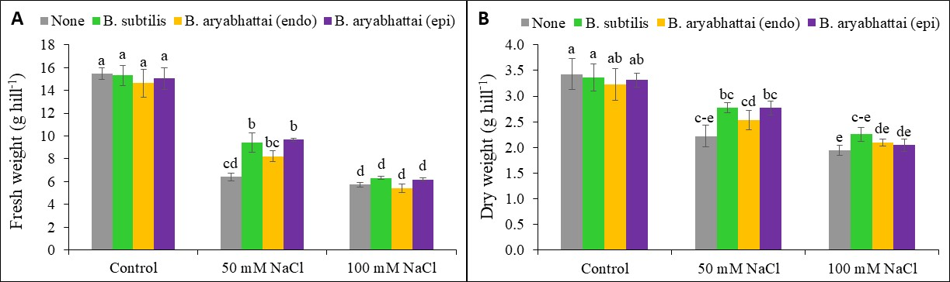
Figure 1. Variations in fresh weight (g hill⁻¹) (A) and dry weight (g hill⁻¹) (B) of rice (Oryza sativa L. cv BRRI dhan100) under varying levels of salt stress (50 mM, and 100 mM NaCl) with endophytic (Bacillus subtilis, B. aryabhattai) and epiphytic (B. aryabhattai) plant growth-promoting rhizobacteria treatments. Here, the results, presented as bars, depict means (± SD) from three independent experimental sets. The column values were tested for significance (P ≤ 0.05) using Tukey's HSD test, and distinct letters on the bars denote significant differences between treatments.

Slide 102
Graphs - Bad

Slide 103
Graphs - Bad
Minor gridlines are unnecessary
Font is too small
Colors are illogical
Title is missing
Shading is distracting

Slide 104
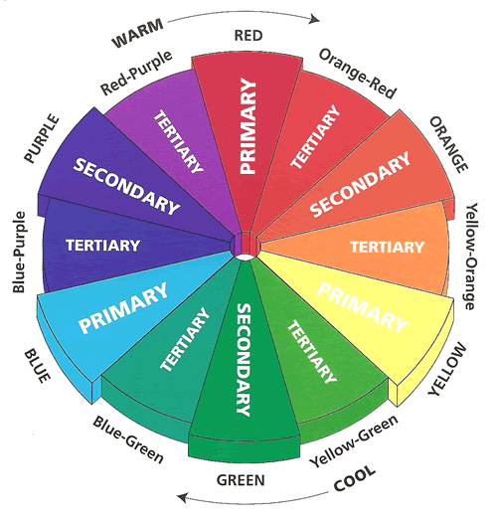
Use color well
Notes:
You do not need to be an expert in color theory, but it's good for business professionals to know at least a bit on the subject.
Colors can be divided into two general categories:
Cool (such as blue and green)
Warm (such as orange and red).
Cool colors work best for backgrounds
as they appear to recede away from us into the background.
Warm colors generally work best for objects in the foreground (such as text)
because they appear to be coming at us.

Slide 105

Take Care with Colors
Notes:
6-8% of males have some degree of color blindness
High contrast
Avoid tonally similar greens/blues vs. reds/purples

Slide 106


Image/Pictures
Use good quality of picture and of actual size and shape

Slide 107




Use of images
Be creative to capture your audience’s attention…

Slide 108

Always use legitimate and offline images.
If hyperlinked, keep them in the same folder

Slide 109

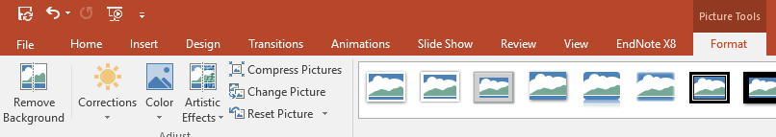
Use of images
The ‘Remove Background’ function takes out the background from pictures and helps them to stand out on your slide. Notice how the sky has been removed from the image of this building.
Avoid putting text over an image as some people find this hard to read.
Find this function under Picture Tools > Format > Remove Background

Slide 110
Centered graphics leave little room for text.

Slide 111
Balance
More room for text
Better balance
Placing graphic on left leads your eye to the text

Slide 112

Adding Sound
Get the reader’s attention with sound
  Make sure sound is appropriate
  Use mouse over sounds for showing a highlight
  Use sound sparingly
Notes:
Jane’s Power Points!
Readers can become focused when you add sound or they can be distracted.
Sounds and video files can be millions of bytes in size. They could slow down your presentation.

Slide 113
Using Animation
Flying
Dissolve
Blinds
Notes:
Jane’s Power Points!
Audiences are impressed the first time they see animated text, and sound is a novelty. However, after seeing these tricks a few times, people quickly tire of them. Less is more in this case.
Notice that Flying is set to “Hide on next mouse click.” This can leave you without all of your information if questions are raised.

Slide 114

Transition
Adding slide transition allows one slide to dissolve gracefully in to the next.
Limit the number of transition used. It is often better to use only one so the audience knows what to expect

Slide 115
Spelling and Grammar
Proof your slides for:
  speling mistakes
  the use of of repeated words
  grammatical errors you might have make
If English is not your first language, please have someone else check your presentation!

Slide 116
Conclusion
Use a conclusion slide to:
  Summarize the main points of your presentation
  Suggest future avenues of research
Use an effective and strong closing
  Your audience is likely to remember your last words

Slide 117

“In the future, It’s not about the competition of knowledge. It’s a competition of creativity, imagination, and independent learning.”
Jack Ma
Co-founder of Alibaba Group

Slide 118
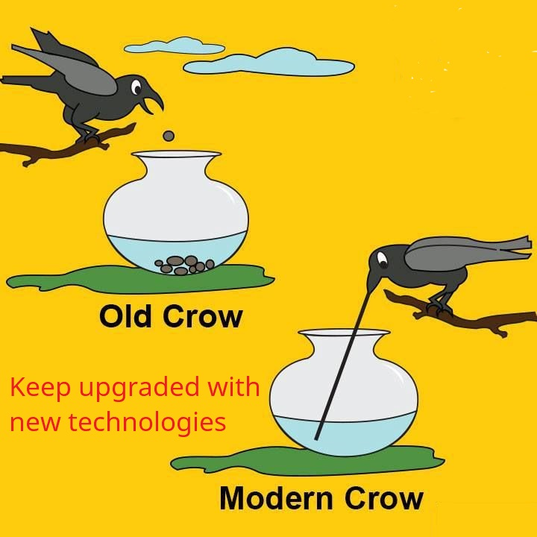
“What new technology does is create new opportunities……”
…and use the technology whenever available and affordable

Slide 119
References?
To cite your sources within a PowerPoint presentation, you can include your references or in-text citations on each slide.
You can (a) provide the references verbally, (b) provide a reference list slide at the end of your presentation with corresponding in-text citations, or (c) combine these.

Slide 120
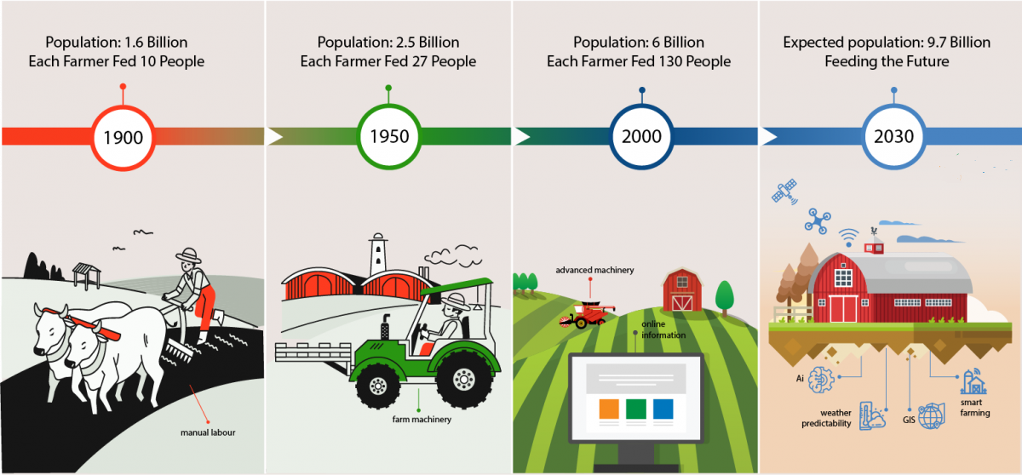
Technology and Innovations can change the scenario
Source: Arilyze (2022)

Slide 121





Thank you
Acknowledgment

Slide 122
Do remember to…
Thank the audience for their attention
Thank you
Notes:
Jane’s Power Points!
Some animated options will annoy your audience. To be conservative, stick with Appear, Fly Left, Peek, and Wipe Down.
Leave a trail. Ask for feedback on your presentation.

Slide 123



For any query:
+88-01716587711
Mail to: mhzsauag@yahoo.com
Web: www.mirzahasan.info.bd
Thank You
どうもありがとうございました
Notes:
123

Slide 124
Questions??
End your presentation with a simple question slide to:
  Invite your audience to ask questions
  Provide a visual aid during question period
  Avoid ending a presentation abruptly

Slide 125


Slide 126
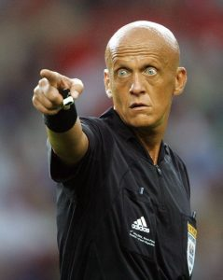
Stay on time
If you plan a certain amount of time for your presentation, do not go over
If there is no time limit, take less time rather than more to ensure that people stay engaged

Slide 127

Do not read the presentation
A sure sign of an ineffective presenter is when he or she looks at the screen and reads off every last word up on the slides
Loses eye contact with the audience
You also don’t want the audience to have to look at your backside all the time
Practice the presentation so that you can speak from bullet points
The text should be a cue for the presenter

Slide 128

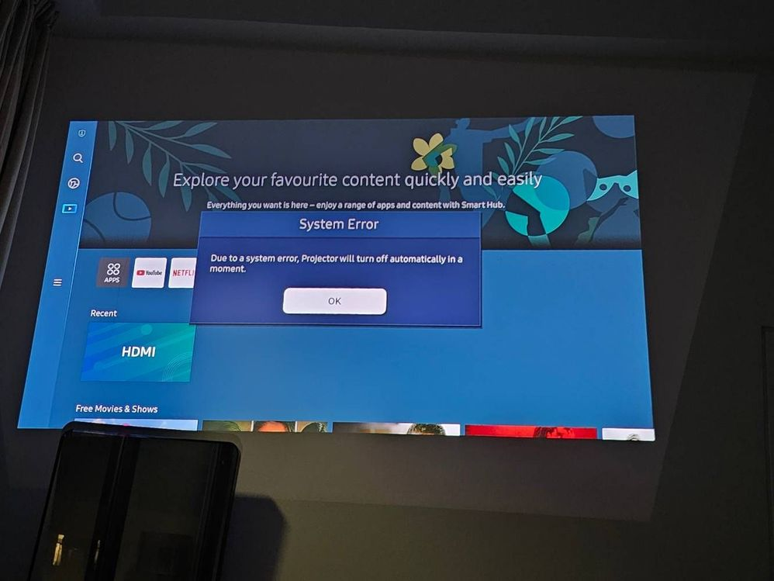
Show up early and verify that your equipment works properly
Make sure that all equipment is connected and running
Verify that the projector's resolution is the same as the computer on which you created your presentation
Arrange cable
Check pointers

Slide 129
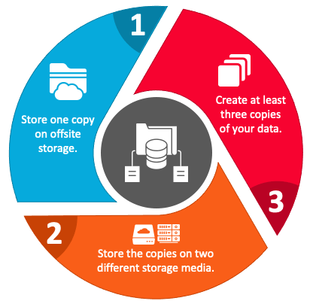
Have a Backup Plan
Technology can fail when least expected
Have a backup copy on a flash drive
Don't assume that your presentation will work fine on another computer
Don’t assume the internet will be connected
From a speaker point of view, it is also a good idea to be able to deliver your presentation without the slides just in case of projector failure

Slide 130

Questions?

